Slide 1
Restful Booker
API Testing Project
Team Members
Hamza Belal
Moneera
Authentication & Health Check
Get Bookings & Filtering
Fadi
Hassan
Booking Creation & Update (PUT)
Partial Update & Delete
https://restful-booker.herokuapp.com

Slide 2
Introduction to Project
Hamza Belal
Project Overview
Project Objectives
The Restful Booker API Testing Project focuses on testing a real-world REST API designed for booking management.
Validate API functionality across all endpoints
Ensure correct handling of requests and responses
Identify bugs and unexpected behavior
Apply different testing techniques (positive, negative, boundary, security)

Slide 3
Introduction to Project
Hamza Belal
🌐 Website Under Test
🛠 Tools Used
Postman
Restful Booker
API request testing & automation
A demo REST API for booking management.
REST API
URL: https://restful-booker.herokuapp.com
HTTP methods: GET, POST, PUT, PATCH, DELETE
Endpoints Covered:
JSON
Request body & response format
/auth — Token Generation
/booking — Create, Read, Update, Delete
/ping — Health Check
Environment Vars
{{base_url}}, {{username}}, {{password}}
Postman Workspace: hamzabelal377-60219.postman.co

Slide 4
What Hamza Did
Hamza
9
Auth
100%
Test Cases
Module
Pass Rate
TC-001 to TC-008 + TC-084
& Health Check
All Passed
Test Cases Covered
ID | Test Case | Status
TC-001 | Create Token – Valid Credentials | Pass
TC-002 | Create Token – Invalid Username | Pass
TC-003 | Create Token – Invalid Password | Pass
TC-004 | Create Token – Empty Username | Pass
TC-005 | Create Token – Empty Password | Pass
TC-006 | Create Token – Missing Username | Pass
TC-007 | Create Token – Missing Password | Pass
TC-008 | Create Token – Special Characters | Pass
TC-084 | Health Check – API is Running | Pass

Slide 5
Testing Process
Hamza
How Hamza Tested the API
Types of Test Cases
1
Identify Auth Scenarios
Positive Testing
Mapped out positive and negative cases for /auth and /ping endpoints
Valid admin / password123 → token returned
2
Configure Postman
Negative Testing
Set up environment variables: base_url, username, password
Invalid username, wrong password → Bad credentials
Empty Field Testing
3
Build Token Requests
Empty username or password fields handled
Created POST /auth requests with different credential combinations
Missing Field Testing
4
Assert Responses
Body without username or password key
Verified status 200, response body contains token or 'Bad credentials'
Special Characters
5
Document Results
Input like admin@##) to check sanitization
Logged pass/fail status for each scenario in the test case sheet
Health Check
GET /ping returns 201 Created (API is running)

Slide 6
What Moneera Did
Moneera
22
GET
100%
Test Cases
Module
Pass Rate
TC-009 to TC-030
Bookings & Get by ID
All Passed
GET /booking (TC-009–019)
GET /booking/:id (TC-020–030)
Fetch all booking IDs and filter the list using query parameters.
Retrieve a single booking by ID and validate the response payload.
Fetch all booking IDs
Filter by firstname, lastname, checkin date
Filter by date range & combined filters
Search for non-existent name (empty array)
Invalid date format handling (500 response)
SQL injection attempt (sanitized result)
Missing endpoint → 404, wrong method → 500
Valid ID retrieval with full booking details
Invalid IDs: non-existent, string, special chars → 404
Boundary IDs: 0, negative, very large (9223372036854775807)
Data integrity: totalprice is number, bookingdates object
Response speed under 1000ms
Authorized access check

Slide 7
Testing Process
Moneera
How Moneera Tested the API
Types of Test Cases
1
Plan GET Scenarios
Positive Testing
Listed filter combinations and ID lookup cases for both GET endpoints
Valid IDs and filters return expected data
2
Build Query Requests
Negative Testing
Created GET /booking with query params: firstname, lastname, checkin, checkout
Non-existent IDs, invalid formats, wrong methods
Boundary Testing
3
Execute Lookups
ID = 0, negative IDs, very large IDs (9223372036854775807)
Sent GET /booking/:id with valid, invalid, edge-case IDs
Security Testing
4
Validate Response Data
SQL injection attempt with ' OR '1'='1
Checked arrays, IDs, field types (totalprice, bookingdates)
Data Integrity
5
Log Findings
Verified totalprice is number, bookingdates has checkin/checkout
Recorded status codes, response times, any anomalies
Performance Check
Response time stays under 1000ms

Slide 8
What Fadi Did
Fadi
26
2
62%
Test Cases
Modules
Pass Rate
TC-031 to TC-056
POST & PUT
POST /booking (TC-031–042)
PUT /booking/:id (TC-043–056)
Create booking with all required fields and valid data
Create without optional additional needs field
Boundary dates: same check-in/check-out, non-existent dates
Special characters in first/last name (O'Neil, Mc'Arthy)
Invalid inputs: empty firstname, price as string → 400
Invalid logic: checkout before checkin, negative price → 400
Edge case: price = 0 accepted (noted as should not be allowed)
Type validation: firstname as number → 400
Full update with valid data using token header
Update using Basic Auth header instead of cookie
Update individual fields: total price, dates, additional needs
Special characters in firstname on update
Send same data with no fields changed
Authentication: without token / without basic auth → 403
Invalid scenarios: non-existent ID (404), empty required field (400)
Date validation: checkout before checkin, string format → 400
State: update a booking that was already deleted → 404

Slide 9
Testing Process
Fadi
How Fadi Tested the API
Types of Test Cases
1
Design CRUD Scenarios
Positive Testing
Mapped valid and invalid payloads for both POST and PUT
Valid payload → booking created / updated successfully
2
Build JSON Bodies
Negative Testing
Crafted request bodies with full booking objects and edge-case variations
Empty firstname, string price, invalid dates → 400
Authentication Testing
3
Handle Authentication
Missing token or Basic Auth → 403 Forbidden
Tested PUT with cookie token and Basic Auth headers
Boundary Testing
4
Send & Verify
Same check-in / check-out, price = 0, negative price
Checked 200 for success, 400 for invalid data, 403 for missing auth
Special Characters
5
Capture Anomalies
Names like O'Neil, Mc'Arthy in request body
Noted behaviors like price = 0 being accepted (TC-041)
State Testing
Attempt to update a booking that was deleted

Slide 10
What Hassan Did
Hassan
27
2
3
Test Cases
Modules
Bugs Found
TC-057 to TC-083
PATCH & DELETE
B01 & B02 &B13
PATCH /booking/:id (TC-057–073)
DELETE /booking/:id (TC-074–083)
Valid updates: single field, multiple fields
Update additionalneeds and special characters in input
Authentication: without auth (403), with invalid token (403)
Edge cases: empty body, null values, malformed JSON
Invalid inputs: wrong Content-Type, invalid data types
Bug findings: excessively long input (B01), unknown fields ignored (B02)
State testing: update after deletion, invalid booking ID
Delete with valid token and recently created booking
Delete using cookie authentication
Verify deletion by GET request returns 404
Delete with invalid ID → 405 Method Not Allowed
Delete without auth or with invalid token → 403
Delete booking twice → 405
Delete with missing or malformed ID → 404 / 405

Slide 11
Testing Process
Hassan
How I Tested the API
Types of Test Cases
1
Define PATCH And Delete Scenarios
Positive Testing
Listed partial-update cases and destructive DELETE scenarios
Valid partial updates applied correctly
2
Prepare Auth Contexts
Negative Testing
Generated tokens and used cookie auth for protected endpoints
Empty body, null values, malformed JSON, wrong Content-Type
Authentication Testing
3
Send Partial Updates
Missing token and invalid token → 403
PATCH with single fields, multiple fields, nested bookingdates
Boundary Testing
4
Validate Behavior
Excessively long input strings (B01 finding)
Expected 200 OK for valid, 403 for no-auth, 405 for bad ID
Schema Testing
5
Discover Bugs
Unknown fields silently ignored (B02 finding)
Found B01 (long input accepted) and B02 (unknown field ignored)
State Testing
Delete twice, update after deletion, verify via GET

Slide 12
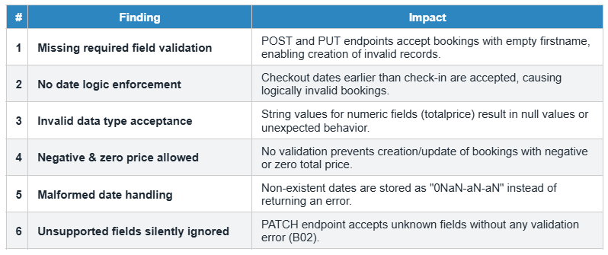
Bug Report
Hassan
13
10
3
Postman
Total Bugs
High Severity
Low Severity
Environment
Critical Issues (High Severity)

Slide 13
What We Learned as a Team
Fadi
1
Team Collaboration Experience
Divided work efficiently across modules (Auth, GET, POST, PUT, PATCH, DELETE)
Maintained clear communication to avoid overlap and confusion
Supported each other in solving issues and understanding API behavior
2
Key Skills Developed
Teamwork and coordination
Time management and task distribution
Consistent documentation and reporting

Slide 14
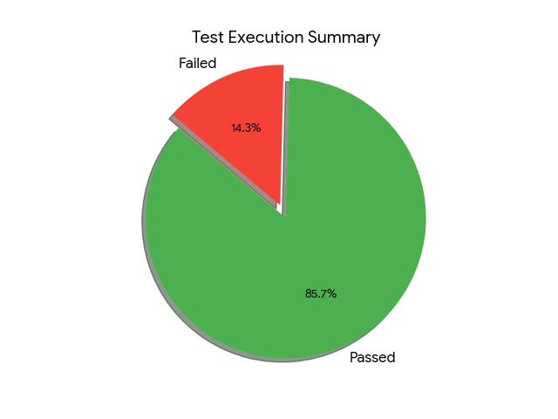
Test Cases Summary
Team
84
71
13
13
Total Test Cases
Passed
Failed
Bugs Found
Coverage by Module
Module | Test Cases | Count | Passed | Owner
Authentication | TC-001–008 | 8 | 8 | Hamza
Get Bookings (List & Filter) | TC-009–019 | 11 | 11 | Moneera
Get Booking by ID | TC-020–030 | 11 | 11 | Moneera
Create Booking (POST) | TC-031–042 | 12 | 6 | Fadi
Update Booking (PUT) | TC-043–056 | 14 | 10 | Fadi
Partial Update (PATCH) | TC-057–073 | 17 | 14 | Hassan
Delete Booking | TC-074–083 | 10 | 10 | Hassan
Health Check | TC-084 | 1 | 1 | Hamza

Slide 15
Thank You!
Restful Booker API Testing Project
Team:
Hamza Belal · Moneera · Fadi · Hasan Aburajab
https://restful-booker.herokuapp.com

